Slide 1
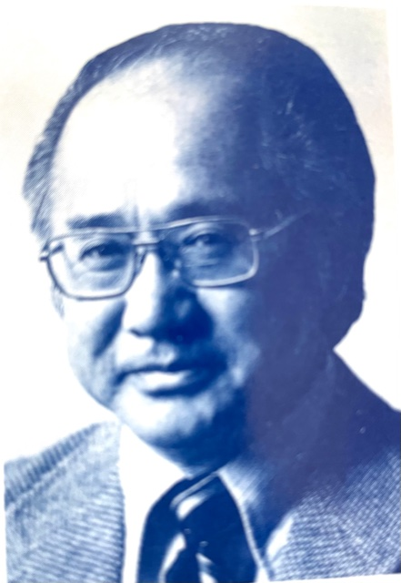
Revisioning Shin Buddhist Teachings for Today:
Thirteen Contributors to a Book, The Tide of Wisdom:
Shinran’s Wisdom, Authentic Individuality and Social Engagement
Dr. Taitetsu Unno Memorial Lecture
The Institute of Buddhist Studies
March 19, 2021
Kenneth K. Tanaka

Slide 2
Opening Remarks
Our appreciation
My personal appreciation
Publication of Dr. Unno’s unfinished translation
Dedication of today’s talk

Slide 3
The Tide of Wisdom: Shinran’s Wisdom, Authentic Individuality and Social Engagement
(New Horizon Seen from Shinshu Theology )

Slide 4
2. Preface
bi-cultural exchange between Japan and North America.
Make up of the 13 contributors to Anthology
Aim: Seek a balance in the tilt toward ”traditional scholarship”

Slide 5
The three dimensions of Shinran’s teachings:
wisdom (chi’e 智慧; prajñā),
2) authentic individuality embraced in wisdom and compassion (shutaisei 主体性),
3) social engagement (shakaisei 社会性)

Slide 6
2. Image of Shin Buddhism
“folk religion. ... [Amidism] twists them into their opposite.”
“This is completely a separate thing from the “Buddhism of Shakyamuni.”
Shin Buddhism is seen as merely devotional, popular, and even a deviation from authentic Buddhism.
Shinran “the consummation of Mahayana Buddhism”

Slide 7
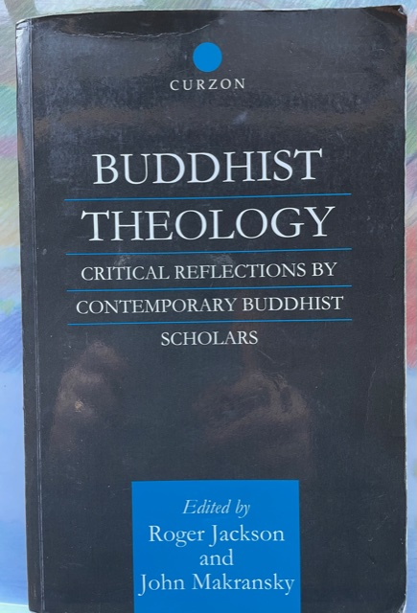
4. Shinshū Theology
Buddhist Theology, published in 2000
“Theology”: “an intellectual interpretation within a religious tradition” “whether that tradition is theistic or not.” David Tracey

Slide 8
4. Shinshū Theology: three features:
not being limited to traditional methods and perspectives,
2) an openness to a global perspective
3) an emphasis on the needs and experiences of the aspirants or seekers.

Slide 9
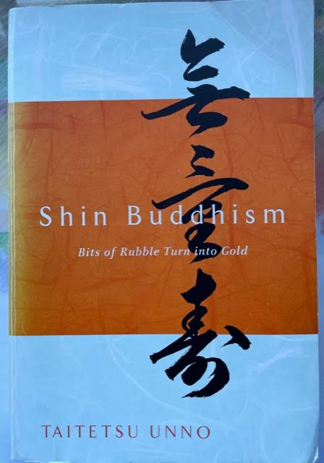
“This tradition of self-cultivation forms the unseen background of Shin Buddhist life, which shuns theoretical discussions and encourages people to embody the teachings.” (p, 41)
Taitetsu Unno

Slide 10
5. Wisdom
Wisdom is a vital feature of Shinjin.
Shinjin is the experience of spiritual awakening
Shinjin is commonly translated as “true entrusting.”
But “entrusting” does not capture the full meaning of Shinjin; also contains meaning of “wisdom”

Slide 11
Four primary features of Shinjin
entrusting (itaku 委託 or kitaku 寄託)
joy (kangi 歓喜)
no doubt (mugi 無疑)
4) wisdom (chi’e 智慧)

Slide 12
Shinran’s hymn :
“It is by entering the wisdom of Shinjin” (shinjin no chie 信心の智慧)
“the emergence of the mind of entrusting oneself to it is the arising of wisdom.” (note)
Traditional scholarship does not address how this wisdom manifests in one’s experience.

Slide 13
Anthology Contributors’ Views (1)
Y. Fuji:
Wisdom manifests in the aspirants in the form of their ethical inclination to reject the Three Poisons.
H. Maeda:
Cites Shinran, who says, “To entrust oneself to the nembutsu is to already have become a person who realizes wisdom

Slide 14
Anthology Contributors’ Views (2)
K. Tanaka: One “truly knows” (shinchi 信知) that
oneself is a foolish being full of blind passions: Onemess!
2) one can attain birth through the Primal Vow: Oneness!
Ichijo Ogawa: One’s “blind passions” are realized within the context of one’s effort on the Buddhist path.
K. Tanaka: Persons of Shinjin attain the initial level of awakening, such as the “Stream-enterer” (Shinran)

Slide 15
Proposal
The seekers’ experience of Shinjin involves a great degree of wisdom (realizing, knowing, insight, etc.).
Thus, besides “true trusting,” Shinjin should also be translated “true realization” or “true awakening.”
“True realization” challenges the image of Shin Buddhism as simply devotional, a folk religion, and a deviation.

Slide 16
6. Authentic Individuality
Embraced in Wisdom and Compassion
Not the same as “individualism” in the secular sense but authentic self that is embraced in wisdom and compassion
“Your own self is your own authentic individuality (Atta hi attano natho)” (Dhammapada 160)
“Amidst the teaching of “non-self” there exists a “true self” (眞我). (Nirvana Sutra)
R. Takeda: In Shin Buddhism, this manifests in myōkōnins (妙好人), “the wondrously excellent persons,” and in “the true disciples of the Buddha”

Slide 17
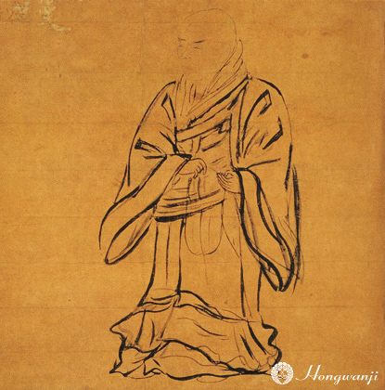
Authentic individuality manifests in the three qualities of Shinran’s action:
the deeply personal nature of his seeking,
I realize that it was entirely for the sake of myself alone!”
2) the importance of the individual in decision-making
“Whether you take up and accept the nembutsu
or whether you abandon it is
for each of you to determine.”

Slide 18
Dr. Alfred Bloom
Prof. Emeritus, Univ. of Hawaii
Former Dean, IBS

Slide 19
Authentic individuality manifests in
the three qualities of Shinran’s action: (2)
the steadfastness of his conviction.
“The emperor and his ministers, acted against the
Dharma and violated human rectitude.”
“Mindful solely of the profundity of the
Buddha’s benevolence, I pay no heed to the
derision of others.”

Slide 20
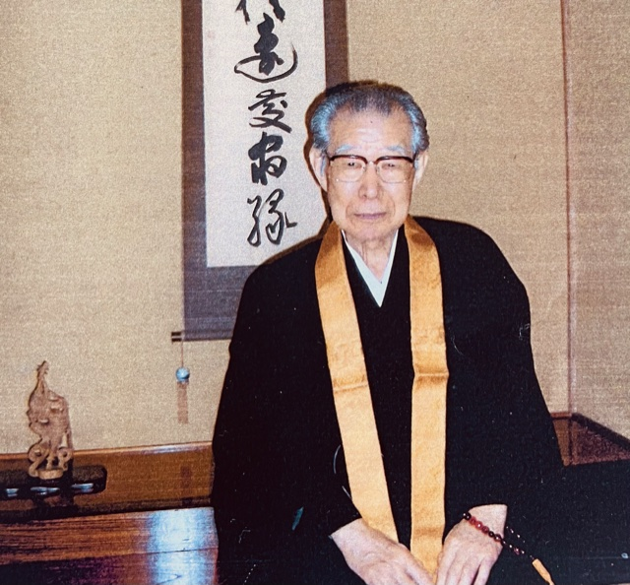
“Hence, one is able to achieve personal transformation and become an ideal human being.
… Ordinarily, we do not live with this kind of independence. Usually, we worry about how other people view us … .
However, when we realize true enlightenment and establish our true selves, then we will be able live in reliance upon ourselves and exist as we are.”
Rev. Prof.Takamaro
Shigaraki

Slide 21
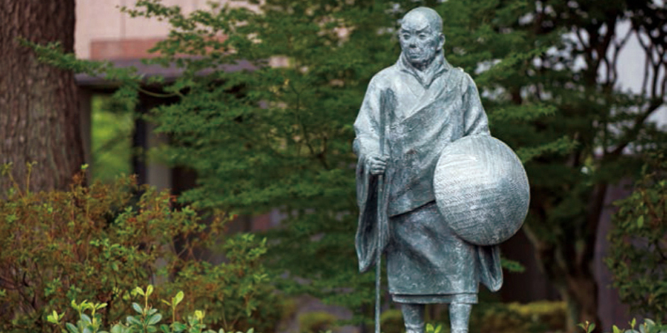
The statue that expressed for me,
“authentic individuality embraced in wisdom and compassion”
(Musashino University, Tokyo)

Slide 22
7. Social Engagement
General perception is that Shin Buddhism rejects this world in favor of the Pure Land.
Not the case with Shinran:
the importance of this present world
2) engagement in activities to benefit others.

Slide 23
Dr. Unno:
“Pure Land Buddhism might suggest an otherworldly orientation, but its primary focus is on the here and now.”
(River of Fire River of Water, p. 12)
“The fifth and final stage reminds us that this is not simply an internal, subjective process and underscores our responsibilities in society. We meet all kinds of challenges – personal, social, and historical – and we vigorously respond to them, knowing that there are no quick and easy solutions.”
(Shin Buddhism, p. 35)

Slide 24
Two factors that mitigate social engagement:
self-power (jiriki)
N. Watanabe: The problem is not effort itself but the attitude or motive behind the effort.
With the right attitude (“practice rooted in gratitude” (hōongyō 報恩業) , Shin Buddhists can engage in Five Correct Practices and “meditation.”
K. Tanaka: We can promote Shinran’s teaching of “Contantly Practicing Great Compassion” to mean more than reciting the Name but also social engagement.

Slide 25
2) a message found in a major Shin text, the Tannishō.
It has discouraged efforts on the ethical and social levels by concentrating on our personal spiritual salvation but to postpone any effort to care for others until we become Buddhas in the next life.
F. Sueki: Disagrees with the above view. He advocates social engagement in this life, for it would be embraced within the workings of Amida’s ‘phase of returning.’
T. Kaku: We need not wait until after death but in this very life we can reach out to support each other with greater confidence that we are participating in the compassionate workings of the Buddha in the phase of returning.
S. Saito: A person is still possessed of blind passion but is no longer your regular foolish being but is, in Shinran’s words, a “white lotus among people.”

Slide 26
8. Religion of Awakening and Action
Not a religion of belief and inaction
D. Hirota: Shinjin is not merely one’s subjective decision or mental function but a self-realization called “holism.”
Shinran’s direct disciples were not illiterate peasants.
Of the 57, only 3 were commoners

Slide 27
9. Revisioning is Already Taking Place in America
Four Evidences
1. the Six Paramitas
2. the Golden Chain
3. the opinion survey
4. social engagement

Slide 28
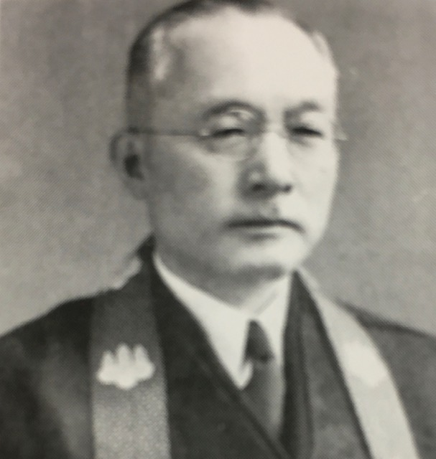
1. the Emphasis on Six Paramitas
Rev. Itzuzō
Kyōgoku

Slide 29
Republished in January, 2021
50 years after it first came
out
Title:
Buddhism of Living
Buddhism of Dying

Slide 30
9. Revisioning is Already Taking Place in America
Four Evidences
2. the “Golden Chain”: enduring and popular
3. the opinion survey: immanent, this worldly, and non-dual
not transcendent, other worldly and dualistic
4. social engagement: Buddhist Life Program, Relevant American
Buddhists, Taiko, Project Dana, Stand in support of BLM, Young Buddhist Editorial

Slide 31
9. Revisioning is Already Taking Place in America
New developments in North America toward a religion
awakening and action
Distinct development is inevitable due to cultural differences
Prof. Tomoyasu Naito: North American Shin Buddhism should
develop its own form

Slide 32
10. The Survival of Shin Buddhist Temples
“Big Tent” supported by a central pole that is
Buddhist in substance, not ethnicity
All the “B-Buddhists” of any ethnicity are welcomed.
But Japanese culture and ethnicity need not be disregarded.
“Spiritual Family”

Slide 33
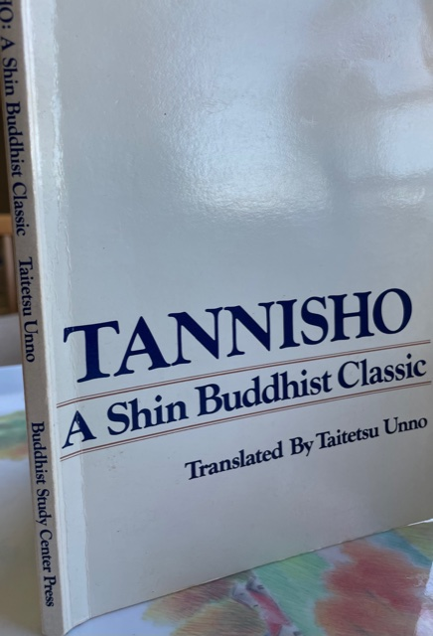
“I, Shinran, have never even once uttered the nembutsu for the sake of my father and mother.
The reason is that all beings have been my fathers and mothers, brothers and sisters, in the timeless process of birth-and-death

